Slide 1

Distributed Task Assigning Management System
by Sai Datha Nagamoni, Patchikoru Girishkumar, Vineela Madduri, and Tiffany Ly

Slide 2
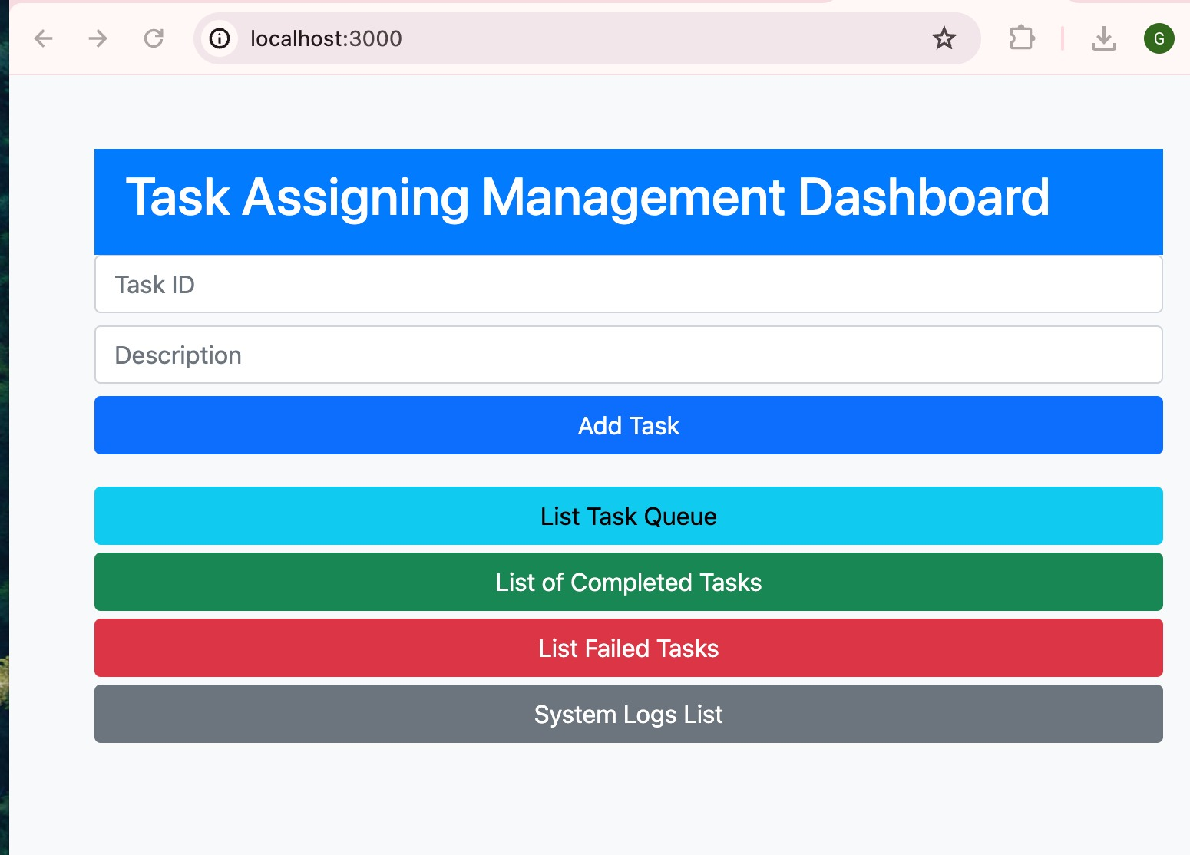
Basic Functions of Distributed Assigning Management System
Distributed Task Assigning Management Manager
The Queue Manager oversees the task queue stored in the server, Redis, monitors worker node status, and assigns tasks to available nodes based on their status.
Dynamic Allocation of Worker Nodes
Worker nodes fetch tasks from their own task files, process the tasks, update their completion status, and report their status to the centralized worker node.
Fig.1. UI Of Distributed Task Queue System
Graphical User Interface
The GUI provides a user-friendly interface for managing and monitoring tasks, allowing users to view worker node status, add new tasks, and show system logs.

Slide 3
Distributed Features in Our System
Scalability
Fault Tolerance
Load Balancing
Data Consistency
The system is designed for horizontal scalability, leveraging Docker containers to deploy multiple instances of the server and Redis database across diverse machines or cloud platforms. This scalability is crucial for handling peak loads, allowing the system to dynamically allocate resources and maintain optimal performance. Additionally, the Node.js cluster module enhances workload distribution across multiple CPU cores, increasing the system's efficiency in managing more concurrent users and tasks.
The system's architecture isbuilt for resilience, featuring robust mechanisms for error management. Redis, employed for data storage, provides persistence capabilities that allow it to restore its state after disruptions. The Bull queue, integrated with Redis, ensures that tasks remain secure despite failures in processing workers, with capabilities for reassigning tasks to alternative workers. Furthermore, the system design supports the automatic recovery of failed components, such as Docker containers, maintaining continuous system availability without disruption.
The system employs a sophisticated message queuing system (Bull) to handle real-time updates effectively, ensuring that task updates are quickly relayed to the front end. This is essential for keeping a uniform and synchronous display of tasks across all user interfaces. The real-time functionality is enhanced by using efficient operations in Redis, which can swiftly update and distribute changes in task status with minimal delay.
Data integrity and consistency in a distributed setting are maintained by employing transactional support in Redis. Transactions guarantee that all operations involved in updating a specific task are executed atomically, which prevents data corruption and assures system-wide consistency.

Slide 4



Addressing Comments from Proposal Presentation
Middleware Replacement
Custom Solution
Advantages
Originally proposed to use the Bull library with NodeJS for task queue management but developed a custom solution to better meet project requirements.
The custom Distributed Task Assigning Management system offers improved fault tolerance, scalability, and data consistency, with a robust architecture for efficient distributed task management.
The custom middleware solution provides greater flexibility and control to address the specific needs of the Distributed Task Assigning Management System.

Slide 5
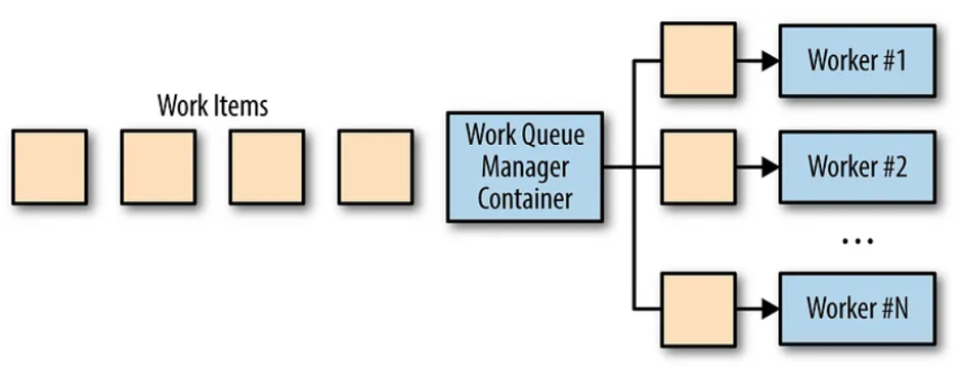
Architecture
Frontend Design
Backend Architecture
Redis Data Storage
Task Scheduling with Bull Queue
Clustering for Enhanced Performance
The application's frontend is built with HTML and JavaScript, using AJAX for backend communication, enabling dynamic content updates without reloading pages. This method provides a smooth user experience by instantly reflecting task updates and statuses on the interface.
The application's backend, built on Node.js, leverages the Express framework to efficiently handle API requests. Express facilitates easy routing and middleware setup, enhancing the management of data flow and operations like adding, updating, and retrieving. This central component of the application coordinates interactions between the frontend, Redis database, and task processing queues.
Redis is used as the primary data storage solution, valued for its rapid processing of key-value pairs. It holds all task-related details such as identifiers, descriptions, and statuses. Using Redis is a strategic decision to ensure quick data access and updates, essential for real-time system performance.
Bull, built on Redis, orchestrates task queues by overseeing the entire lifecycle of each task, from start to finish, ensuring orderly and dependable processing. This queuing mechanism is vital for managing system workflows, prioritizing tasks, and maintaining consistent and reliable execution.
The application leverages the Node.js cluster module to distribute workload across various CPU cores, boosting its ability to manage concurrent requests and increasing system resilience and efficiency.

Slide 6
Workflow Distributed Assigning Management System
1
Task Submission
2
Task Distribution
Users can submit tasks through the GUI interface, which are then added to the centralized task queue managed by the distributed task assigning manager.
The distributed task assigning manager monitors the task queue and worker node status, then assigns new tasks to available worker nodes to optimize throughput.
3
Task Processing
4
Status Reporting
Worker nodes fetch tasks from the queue and process them concurrently, maximizing efficiency and minimizing overall completion time.
Worker nodes update the task completion status and report back to the Queue Manager, which then updates the task queue and user-facing status.

Slide 7
Project Contributions
Backend Development
1
Girishkumar Patchikoru & Sai Datha Nagamoni led the backend development, focusing on task queue management and worker node logic, contributing 25% each to the project.
2
Frontend Design
Vineela Madduri collaborated on the frontend development, designing and implementing the GUI, each contributing 25%.
System Integration
3
Tiffany Ly coordinated the communication between components and oversaw the testing process, contributing 25% to the overall project.

Slide 8
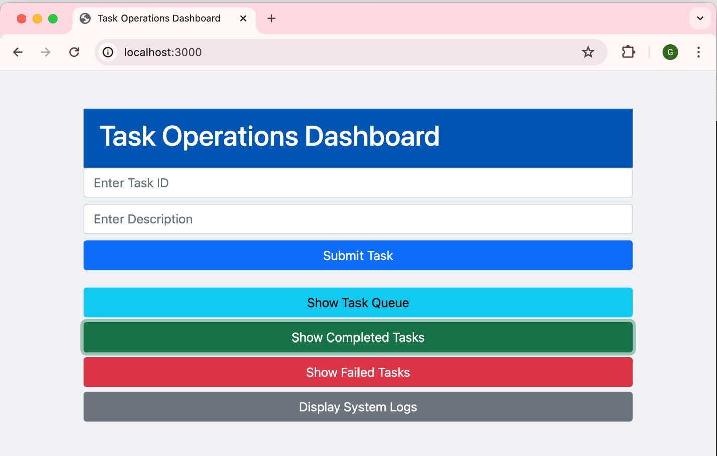
Live Demo: Distributed Task Assigning Management System

Slide 9
References
Stack Overflow. (2019, Jan 22). Python distributed task queue for different specific workers. Stack Overflow. https://stackoverflow.com/questions/54308524/python-distributed-task-queue-for-different-specific-workers
Brendan, B. (2018). Distributed System Fundamentals. In Designing
Distributed Systems (Chapter 10). O'Reilly. https://www.oreilly.com/library/
view/designing-distributed-systems/9781491983638/ch10.html
Yeshwanth, N. (2023, November 21). Celery - A Distributed Task Queue.
LinkedIn. https://www.linkedin.com/pulse/celery-distributed-task-queue-
yeshwanth-n-gdofc

Slide 10
Questions?

